Slide 1
Business at OECD Employment, Labour & Social Affairs Committee Meeting

Slide 2
Agenda
16:00 Welcome & Setting the Scene
16:05 Recent Developments & Upcoming Activities
16:15 Business at OECD ELSAC Committee Deliverables & Priorities
16:45 Exchange with the OECD on Labour Migration Workstreams
OECD Guest: Jean-Christophe Dumont, Head of the International Migration Division
17:30 Exchange with the OECD on AI Workstreams
OECD guest: Stijn Broecke, Senior Economist in the Skills and Future Readiness Division
18:00 Closing Remarks

Slide 3
Important Dates
13 November 2026: GAN Global & Business at OECD joint event “Pathways to Prosperity: How Companies Build First-Job Opportunities through Apprenticeships and Work-Based Learning” at the OECD (in-person only)
17-18 November 2026: OECD Local Employment and Economic Development (LEED) Committee
19-20 November 2026: OECD Working Party on Social Policy (hybrid)
5-6 April 2027: OECD Working Party on Employment
7-8 April 2027: OECD Employment, Labour & Social Affairs Committee
16-18 June 2027: OECD Working Party on Migration
13-14 October 2027: OECD Employment, Labour & Social Affairs Committee
18-19 November 2027: OECD Working Party on Social Policy

Slide 4
Introduction to OECD Employment Outlook 2027: Artificial Intelligence, Digitalisation, and Productivity
Proposed chapters:
    Labour market developments
    Beyond the buzz: The effects of artificial intelligence on firms and workersArgentina (spring 2028)
    The world five years after ChatGPT: What are the current views of employers and workers about artificial intelligence?
    AI and the skills imperative
    Which jobs will be augmented by AI?
    Performance gains in Public Employment Services through AI
    Gears shifting: Workers and the automotive transition
    Making immigration work better for migrants and firms
  Business at OECD will receive the draft chapters for review/circulation among our members in March 2027 & will provide oral comments at the Working Party on Employment (5-6 April 2027)

Slide 5
Introduction to OECD Skills Outlook 2027
The 2027 edition will address the broad topic ““How can skills policies adapt to address distinct challenges and opportunities facing key economic sectors?”
Proposed chapters:
    Chapter 1: Skills and economic sectors
    Chapter 2: Skills challenges, opportunities and policies in the manufacturing sector
    Chapter 3: Skills challenges, opportunities and policies in construction (TBC)
    Chapter 4: Policy lessons on the role of sectoral skills policies
  Business at OECD will have the opportunity to discuss and provide guidance on the initial findings at the OECD ELSAC meeting (7-8 April 2027) and the OECD EDPC meeting (15-16 April 2027).
Notes:
- The biennial OECD Skills Outlook series represents a continuous effort by the OECD Centre for Skills to provide new insights into skills issues and policies that influence the well-being of individuals and countries.
Since the first edition in 2013, each Skills Outlook has covered a particular theme
Based on feedback from Education Policy Committee (EDPC) delegates, the preferred broad topic of the Skills Outlook 2027 was “How can skills policies adapt to address distinct challenges and opportunities facing key economic sectors?” [SKC/EDPC(2026)4]. Delegates’ interest reflected current reforms aimed at making education and training more responsive to changing skill needs across sectors of the economy. These reforms seek to better align skills development with sector-specific labour market demand through apprenticeships and work-based learning, timely curriculum and qualification updates, stronger skills intelligence, micro-credentials and stackable qualifications, and closer collaboration with employers and social partners (OECD, 2023[2]).

Slide 6
OECD ELSAC Accession Reviews
Accession processes are currently underway with 8 countries: Argentina, Brazil, Bulgaria, Croatia, Indonesia, Peru, Romania, Thailand
The OECD ELSAC is planning upcoming confidential reviews of the following countries:
    Thailand (spring 2027)
    Indonesia (fall 2027)
    Argentina (spring 2028)
    A third accession review for Peru in fall 2027
Ahead of each of these reviews, BIAC & TUAC are invited to submit comments to the OECD Secretariat and/or ELSAC delegates at any stage
On October 16 at 11:00, the OECD ELSAC will hold a roundtable on informality and labour law enforcement – opportunity for peer learning between OECD member and accession countries
  Business at OECD will share key points from our recent paper, Breaking the Informality Trap in Latin America and the Caribbean: Business Perspectives on Formalization, Productivity and Inclusive Growth

Slide 7
Upcoming Committee Policy Paper:
Supporting Today’s Entry-Level Workers in an Evolving Labour Market
Will be published for the GAN / Business at OECD joint event on 13 November
The goals of the paper:
  Examine the challenges facing entry-level workers in today's labour market
  Highlight how businesses and governments are responding to support successful transitions from education to employment
  Identify barriers that limit employer efforts to support entry level workers
  Offer recommendations for the OECD and policymakers to better prepare young people for work and strengthen future workforce pipelines

Slide 8
I: Current Challenges Impacting Entry-Level Workers
Rising educational attainment, but persistent skills mismatches
    Educational attainment at an all-time high across OECD countries, but educational attainment does not necessarily translate into labour-market-relevant skills
Declining entry-level opportunities & increases in youth unemployment
    The OECD Employment Outlook 2026 reports that the unemployment rate of young college graduates has been increasing relative to the unemployment rate of the overall population since before the COVID-19 pandemic
Changing skills demands leading to skills mismatches and labour shortages
    Business at OECD members report a shortage of applicants who are adequately prepared for the workplace, as demand for skills is shifting toward increasingly interpersonal, cognitive, and adaptive skills

Slide 9
II: Potential Explanations for Challenges Impacting Entry-Level Workers
AI and technological change
    AI and other technological advancements increasingly cited as explanations for why entry-level workers are struggling to find employment
    Concerns about AI automation are shaping young people’s perceptions of the labour market
    However, the OECD finds that so far, AI has played a limited role in explaining the difficulties entry-level workers face
Evolving economic conditions
    Combination of global economic uncertainty, high interest rates, and geopolitical tensions coupled with ongoing technological change has led some employers to adopt a more cautious hiring approach

Slide 10
III: Changes in Hiring Patterns and Skill Expectations for Entry-Level Workers
Increasing value of interpersonal skills alongside AI literacy
    Soft skills such as problem solving, teamwork, critical thinking, empathy, work ethic, and adaptability to changing technologies have become more important for entry-level workers over the past years
Greater emphasis on prior practical experience and workplace readiness
    Survey respondents report that prior practical experience has become an important differentiator among entry-level candidates
Implications for education and training systems:
    Adapt more quicky to evolving labour market demands
    Place greater emphasis on transferable and interpersonal skills, alongside foundational skills and AI literacy
    Expand work-based learning opportunities

Slide 11
IV: Business and Government Initiatives to Support Today’s Entry-Level Workers
Training and apprenticeship programmes targeted toward youth
    GAN Global
    L’Oréal for Youth
    The Social Service Industry of Brazil
Partnerships between industry, education and government
    Lewiatan’s Better Skilled Project (Poland)
    Assolavoro and the Italian Ministry of Education
    Randstad – Enactus Italy Partnership
Career readiness programmes, networking and counselling
    ManpowerGroup and Junior Achievement Worldwide
    L’Oréal for Youth
    Randstad RiseSmart
    Sabancı Holding Youth Mobilisation Initiative (Türkiye)
Skills-based hiring practices

Slide 12
V: Challenges and Barriers Facing Businesses in Their Efforts to Support Entry-Level Workers
Administrative and regulatory barriers to hiring entry-level workers
    Regulatory complexity, frequently changing incentive structures, administrative burdens
Education & training systems struggling to keep pace with labour market change
    The primary responsibility for ensuring that young people acquire labour-market-relevant skills lies with education and training systems
Insufficient investment in lifelong learning
    Financial constraints are a significant obstacle to employer investment in skills development, particularly for SMEs
Limited capacity and incentives to provide workplace learning opportunities
    Differences in capacity across firms and sectors can lead to unequal access to workplace learning
Limited capacity to support workplace integration beyond technical skills
    Importance of collaboration between business, education providers, and public authorities on mentoring programmes, workplace immersion, young professional networks

Slide 13
VI: Recommendations for the OECD & Policymakers
Recommendation 1: Better align education systems and labour market needs, particularly through the modernisation of qualifications and certification frameworks
Recommendation 2: Strengthen lifelong learning frameworks and access to work-based learning opportunities, including apprenticeships
Recommendation 3: Reduce administrative and regulatory complexity to enable the hiring, training, and retention of entry-level workers, and enable more diverse forms of work
Recommendation 4: Strengthen career guidance programmes in schools through public-private partnerships
Recommendation 5: Reinforce the OECD’s work on youth in the context of wider labour market transformations

Slide 14
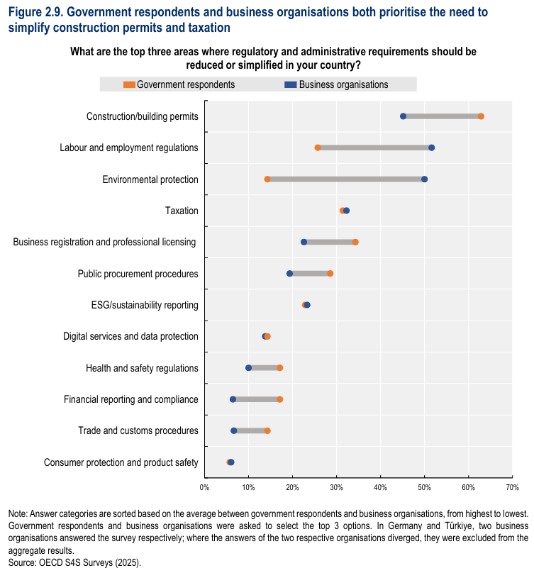
Business at OECD Statement on Regulatory Simplification in Labour & Social Policy
This initiative is part of Business at OECD’s overarching engagement with the OECD on regulatory simplification in the context of “Simplifying for Success”
Survey conducted among members in July & August
Draft statement circulated for review and additional input
Key context:
While essential for safeguarding workers, fundamental rights and ensuring fair labour standards, an overly burdensome or poorly designed regulatory environment can serve as an impediment to growth, slowing job creation and employment, particularly for smaller firms with limited administrative capacity.

Slide 15
Business at OECD Statement on Regulatory Simplification in Labour & Social Policy
Key points:
Administrative burdens associated with working-time regulations and social insurance contributions and reporting were considered highly significant
Main issues flagged: reporting and documentation requirements, labour inspections and audits, employment contracts and hiring procedures, fixed-term employment rules, cross-border mobility and occupational health and safety requirements
  Also challenges in understanding recent legislative changes and inadequate lead times for new or recent legislative changes; violation of “once only” principle
Estimated compliance cost depending on the size of the company around €50,001–€250,000 or more than €250,000
Impacts ranged widely from those on productivity, hiring of new workers, investment decisions, innovation and ability to scale-up cross-border operations.
The wide diversity of national labour laws, and enforcement practices, particularly in the European Union, was highlighted as a specific challenge for businesses operating in more than one country

Slide 16
Business at OECD Statement on Regulatory Simplification in Labour & Social Policy
Key recommendations:
Engage more broadly with businesses to explore specific regulatory issues to be considered and seek input on possible solutions;
Conduct routine ex-post evaluations to keep regulatory frameworks up-to-date and prevent them from becoming unduly burdensome;
Commit to dialoguing with businesses and making information on applicable rules and requirements available in more accessible formats and with advance notice of relevant and applicable changes;
Focus on effective sharing of business-reported data within the public sector (in application of the “once only principle” whereby businesses should only have to provide the same information once to any service prpvider at any level or branch of government);
Ensure regulatory frameworks support job creation by reducing barriers to hiring and enabling businesses to adapt to evolving labour market needs.

